Slide 1
Hobby Web Application Project – The Boxing Hall of fame

Slide 2

Introduction
Presented by Dinesh Vijayan – Trainee software engineer.
This project was approached through agile methodologies with the aim to create a web application using HTML/CSS and JS for the front-end and using a JAVA-Spring framework for the back-end.

Slide 3
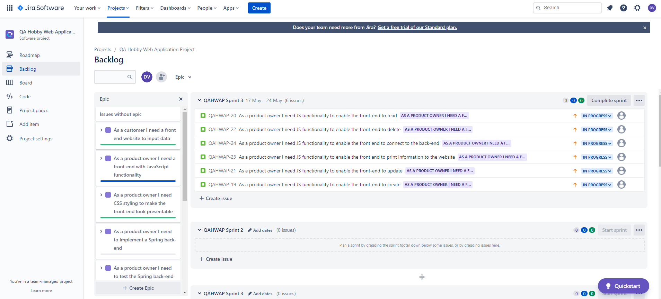
The Sprint Plan

Slide 4




Consultant Journey
The following technologies were learned and applied for the project:
HTML
JavaScript
CSS
Spring
Selenium
SonarQube

Slide 5
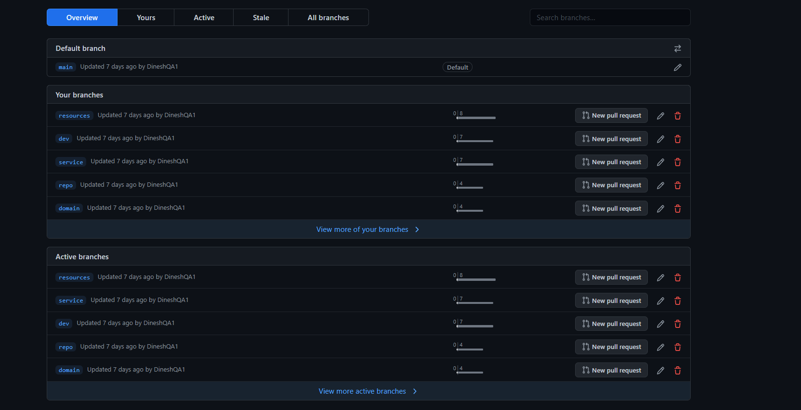
Version Control
Version control was implemented through GitHub using development and feature branches,

Slide 6
Demonstration

Slide 7

Sprint Review
Testing not complete
Application functionality not complete

Slide 8
Sprint Retrospective
What went well?
Front End Design
What Could be improved?
JavaScript functionality
Speed of coding

Slide 9
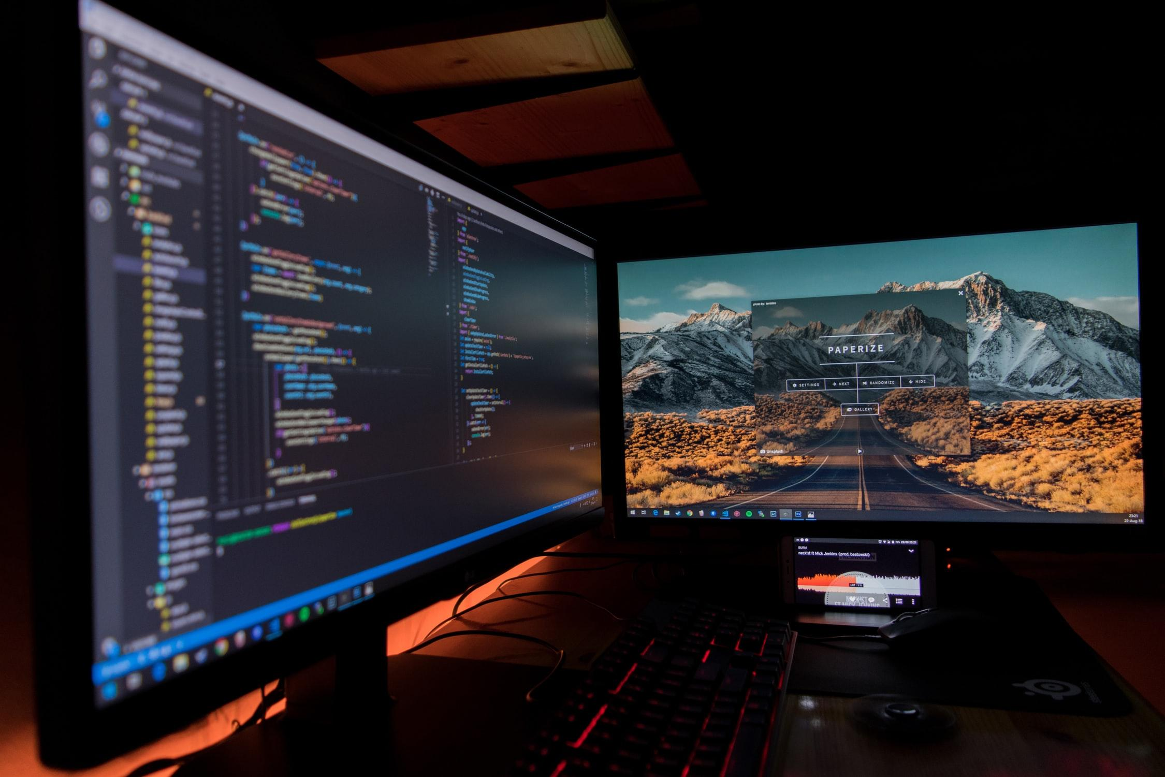
Conclusions

Slide 10
Thank you!

